Slide 1

Operating Systems CSEN1101 Module 1
Prof. G.Apparao
Professor
Department of Computer Science and Technology
GITAM Institute of Technology (GIT)
Visakhapatnam – 530045
Email: agidutur@gitam.edu

Slide 2

Course Objectives
To introduce students with basic concepts of operating system, its functions and services.
To provide the basic concepts of process management and synchronization.
To familiarize the dead lock issues.
To understand the various memory management schemes.
To give exposure over mass storage structures and system protection.

Slide 3
Course Outcomes
At the end of the course the student will be able to
Illustrate the basic and overall view of operating system (L2)
Analyze the concept of a process, process life cycle, process states and state transitions (L4)
Implement and practice CPU scheduling strategies, process synchronization techniques and memory-management schemes (L3)
Simplify and resolve Deadlock handling situation (L4)
Evaluate Disk storage management, protection and security mechanisms

Slide 4
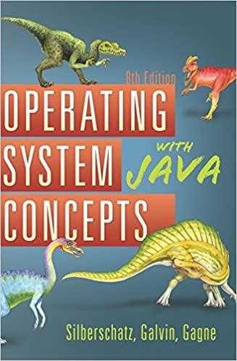
Text Book

Slide 5
Module 1: Operating system Structures - Contents
Operating system Structures:operating system services
System calls,Loaders and Linkers
O.System structure
Building and booting OS
What Operating Systems Does
Computer-System Organization
Computer-System Architecture
Operating-System Structure
Resource Management
Protection and Security
Kernel Data Structures

Slide 6
Structure - Top Level
Peripherals
Computer
Central
Processing
Unit
Main
Memory
Computer
Systems
Interconnection
Input
Output
Communication
lines

Slide 7
Operating System
A modern computer consists of:
One or more processors
Main memory
Disks
Printers
Various input/output devices.
Managing all these varied components requires a layer of software – the Operating System (OS).

Slide 8
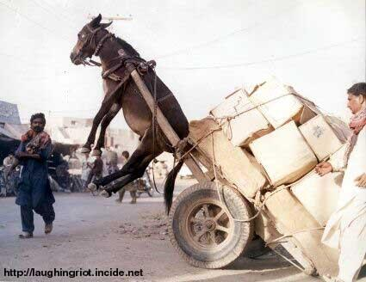
An Unbalanced System
I/O, Memory, Cache
CPU
Source: Bob Colwell keynote ISCA’29 2002

Slide 9
Operating System
So we need a program(OS) that manages a computer hardware.
It also provides a basis for application program and acts as an interface b/w user and the hardware.
Definition of OS:
An operating system is a software that acts as an interface b/w the User and the Hardware.
Implementing an OS is a complex task, it must be created piece by piece.
Each piece should be well-defined portion of the system with defined i/o and functions.
The perspective of the Computer System is
End-user uses the application program
Application program uses the System s/w
OS program uses the hardware to implement s/w
Source: Bob Colwell keynote ISCA’29 2002

Slide 10
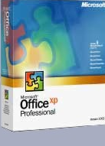


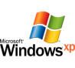
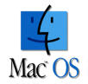
Software
A set of instructions that tells the computer what to do
Two main types of software
System software
Application software
System Software
Application Software
Notes:
The term software refers to a set of instructions that tells the computer what to do. These instruction sets, also called programs, provide a means for us to interact with and use the computer.
Your computer has two basic types of software: system software and application software.

Slide 11
System Software vs. Application Software
System Software
Coordinates instructions between software and hardware
Includes
Operating system
Utility programs, like floppy drive formatter
Device drivers
Application Software
Programs used to complete tasks
Includes
Productivity software like Microsoft Office
Specialty software
Entertainment software
Educational and reference Software
Personal software
System software helps run the computer and coordinates instructions between application software and the computer’s hardware devices. System software includes the operating system, utility programs (programs often in the operating system that help manage system resources), and device drivers.
Application software is what you use to do tasks at home, school, and work.

Slide 12
System Software includes the Operating System and all the utilities that enable the computer to function.
System software is a term referring to any computer software which manages and controls the hardware so that application software can perform a task.
Example: Operating Systems, Compiler, Loader, Linker, Interpreter.
Application Software includes programs that do real work for user.
Example: Payroll systems, Inventory Control, Manage student database, Word Processor, Spreadsheet and Database Management System etc.,

Slide 13
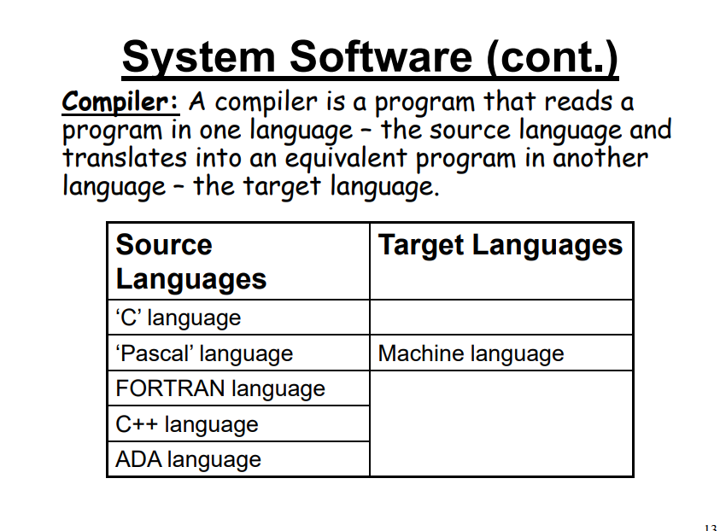

Slide 14
Examples of Operating Systems
Laptops, tablets, and desktop computers all run operating systems that you've probably heard of. Some examples include versions of Microsoft Windows (like Windows 10, Windows 8, Windows 7, Windows Vista, and Windows XP), Apple's macOS (formerly OS X), Chrome OS, BlackBerry Tablet OS, and flavors of Linux, an open-source operating system
Examples: Windows, Linux, Unix and Mac OS, etc.,

Slide 15
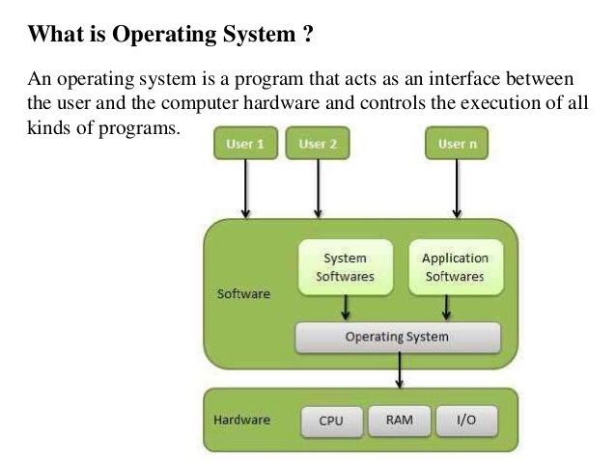


Slide 16
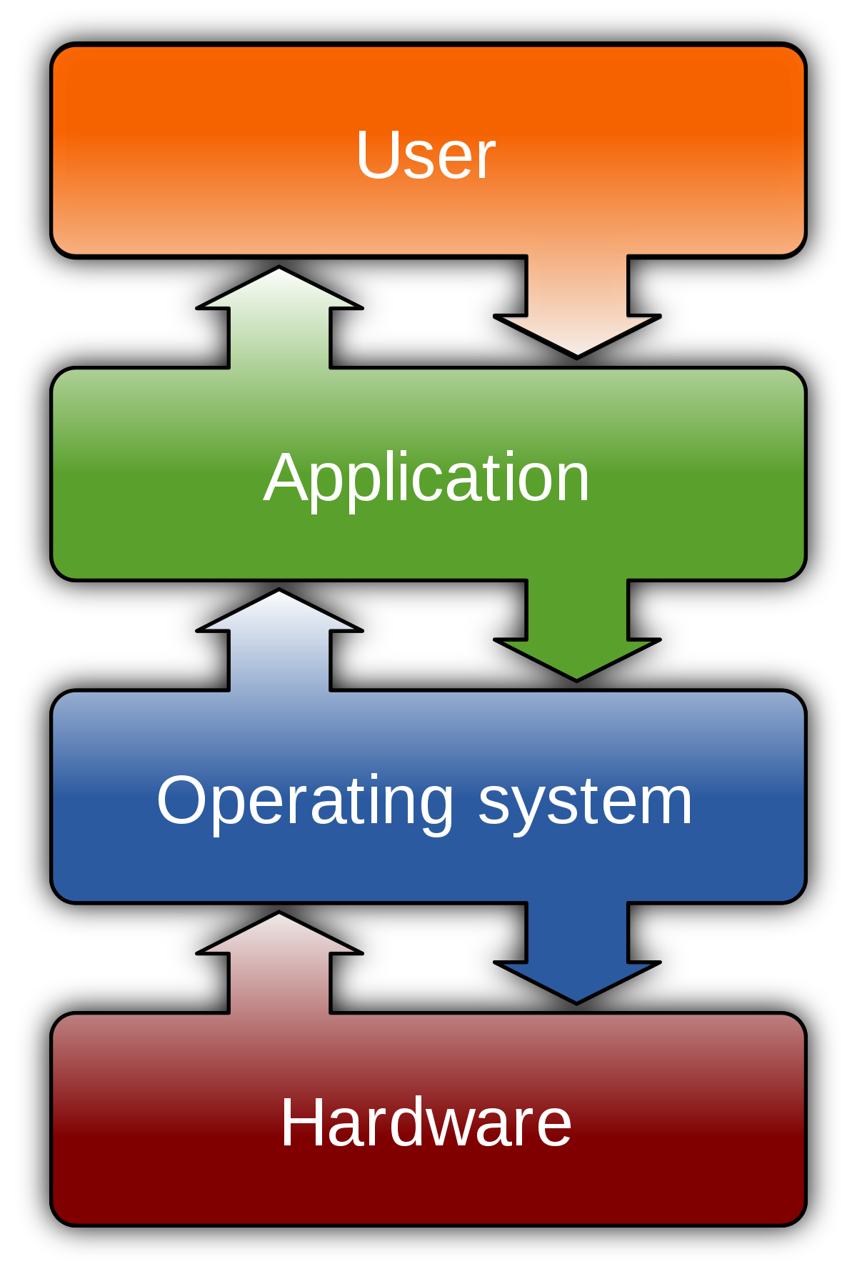
Introduction to OS
Computer system is divided into
1. Hardware
2. Operating system
3. Application program
4. Users
A computer System can be divided into four components:
Hardware: CPU, memory and the i/o devices- provides the basic computing resources for the system.
Application Programs: Word processor, e-mails, web browsers- define the ways in which these resources are used to solve user’s computing problems.
Operating System: acts as an interface b/w the hardware and the User.
User: uses Application programs to interact with the hardware with the help of OS
End user employs the application program.
Application programs uses the system software to produce an application program for end user.
Operating system programmers uses the hardware to implement system software.

Slide 17
History of OS
Operating systems were first developed in the late 1950s to manage tape storage
The General Motors Research Lab implemented the first OS in the early 1950s for their IBM 701
In the mid-1960s, operating systems started to use disks
In the late 1960s, the first version of the Unix OS was developed
The first OS built by Microsoft was DOS. It was built in 1981 by purchasing the 86-DOS software from a Seattle company
The present-day popular OS Windows first came to existence in 1985 when a GUI was created and paired with MS-DOS.

Slide 18
WHAT IS AN OPERATING SYSTEM?
An interface between users and computer hardware(CPU,Memory,printers etc) - an environment "architecture”
Resource allocator: giving resources to processes(CPU,/Device/Memory/File)
Process1: Memory
Process2: CPU
Process3: Printer
Manages all resources
Decides between conflicting requests for efficient and fair resource use
Manager/Control Program: memory(free,allocated), processes(scheduling, everygm has a process, process has states,which state?),files,security etc
Controls execution of programs to prevent errors and improper use of the computer
Allows convenient usage; hides the tedious stuff
Allows efficient usage; parallel activity, avoids wasted cycles
Provides information protection
Gives each user a slice of the resources

Slide 19
Definition of Operating System
An operating system acts as an intermediary between the user of a computer and computer hardware. The purpose of an operating system is to provide an environment in which a user can execute programs in a convenient and efficient manner.
An operating system is a software that manages the computer hardware. The hardware must provide appropriate mechanisms to ensure the correct operation of the computer system and to prevent user programs from interfering with the proper operation of the system.

Slide 20
Definition of Operating System
Operating System – Definition:
An operating system is a program that controls the execution of application programs and acts as an interface between the user of a computer and the computer hardware.
A more common definition is that the operating system is the one program running at all times on the computer (usually called the kernel), with all else being application programs.
An operating system is concerned with the allocation of resources and services, such as memory, processors, devices, and information. The operating system correspondingly includes programs to manage these resources, such as a traffic controller, a scheduler, memory management module, I/O programs, and a file system.
Operating system is a system software that manages computer resources (hardware as well as applications), acts as an intermediary between a user and computer hardware and makes computer system convenient to use

Slide 21
Examples of OS
The 5 most popular operating systems.
Microsoft Windows.-
Apple macOS.
Google's Android OS.
Apple iOS.
Linux Operating System.

Slide 22
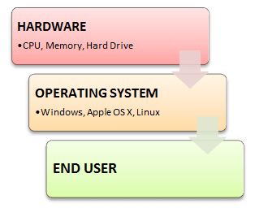
Introduction to OS
Every computer system must have at least one operating system to run other programs. Applications like Browsers, MS Office, Notepad Games, etc., need some environment to run and perform its tasks.
The OS helps you to communicate with the computer without knowing how to speak the computer's language.
It is not possible for the user to use any computer or mobile device without having an operating system.

Slide 23
What OS does?
An operating system performs basic tasks such as,
controlling and allocating memory,
Process Management
prioritizing system requests,
controlling input and output devices,
facilitating networking and
managing file systems.

Slide 24
Functions of OS
Functions of Operating system – Operating system performs three functions:
Convenience: An OS makes a computer more convenient to use.
Efficiency: An OS allows the computer system resources to be used in an efficient manner.
Ability to Evolve: An OS should be constructed in such a way as to permit the effective development, testing and introduction of new system functions at the same time without interfering with service.

Slide 25
Features of Operating System (OS)
Here is a list important features of OS:
Protected and supervisor mode
Allows disk access and file systems Device drivers Networking Security
Program Execution
Memory management Virtual Memory Multitasking
Handling I/O operations
Manipulation of the file system
Error Detection and handling
Resource allocation
Information and Resource Protection

Slide 26
Advantage of using Operating System
Allows you to hide details of hardware by creating an abstraction
Easy to use with a GUI
Offers an environment in which a user may execute programs/applications
The operating system must make sure that the computer system convenient to use
Operating System acts as an intermediary among applications and the hardware components
It provides the computer system resources with easy to use format
Acts as an intermediator between all hardware's and software's of the system

Slide 27
Disadvantages of Operating System
If any issue occurs in OS, you may lose all the contents which have been stored in your system
Operating system's software is quite expensive for small size organization which adds burden on them. Example Windows
It is never entirely secure as a threat can occur at any time

Slide 28
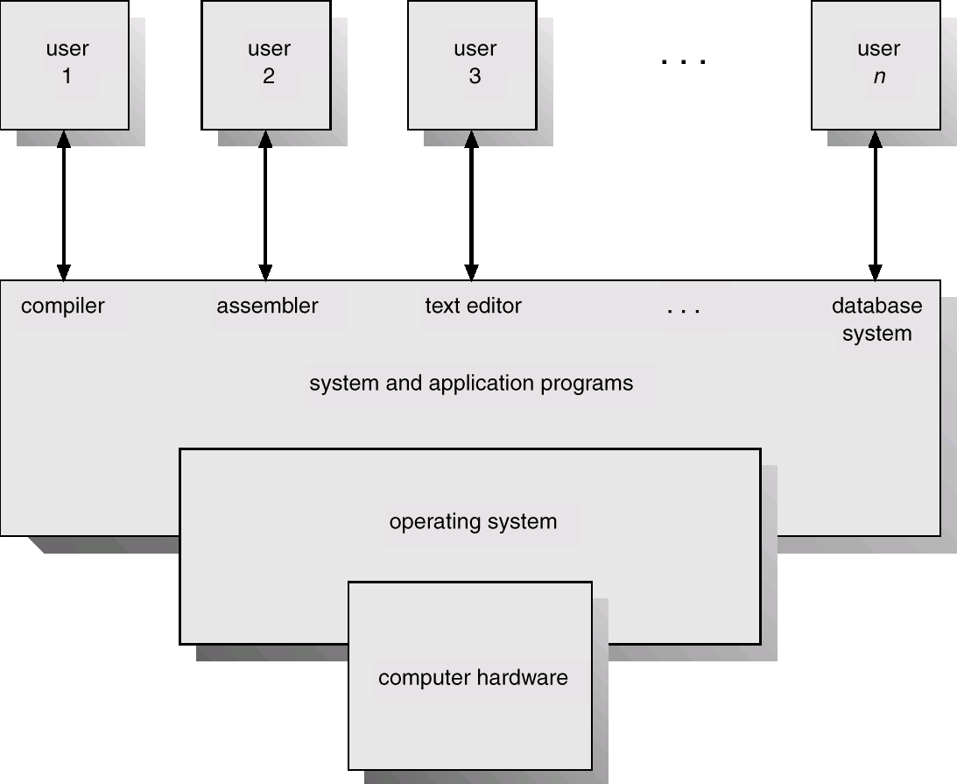
Abstract View of the components of a computer System
Humans
Program Interface
User Programs
O.S. Interface
O.S.
Hardware Interface/ Privileged Instructions
Disk/Tape/Memory

Slide 29
How operating system is different from other system software
1. Operating system directly interact with network, it is also a part of system software.
2. It manages peripheral devices
3. It looks after the memory management
4. It allocates resources
5. It looks the CPU not to sit idle.
Operating system can be viewed in two ways
a) User view
b) System view

Slide 30
Perspective of the System:
User view: The user view depends on the system interface that is used by the users.
Some systems are designed for a single user to monopolize the resources to maximize the user's task. In these cases, the OS is designed primarily for ease of use, with little emphasis on quality and none on resource utilization.
The user viewpoint focuses on how the user interacts with the operating system through the usage of various application programs. In contrast, the system viewpoint focuses on how the hardware interacts with the operating system to complete various tasks.
Personal Computer- designed for one user to monopolize its resources. The goal is to maximize the work that the user is performing(importance is given to performance rather than resource utilization(Convenient way)
Mainframe or minicomputer- Users access the same computer through other terminals, these users share resources and may exchange information- in this case OS is designed to maximize resource utilization(CPU time, memory, I/O are used effective manner.

Slide 31
Perspective of the System
2. System View:
OS is the program involved with hardware.
OS is a resource allocator.
Computer has many resources that may be required to solve a problem and OS manages these resources by coordinating among processes.
So that it can operate Computer system efficiently and fairly.
An OS is a Control Program manages the execution of user programs to prevent errors and improper use of the computer

Slide 32
Types of Operating Systems
1.Batch Operating system
2. Multi-programmed system
3. Time sharing system
4. Multi-processor system
5. Distributed system
6. Real time system

Slide 33
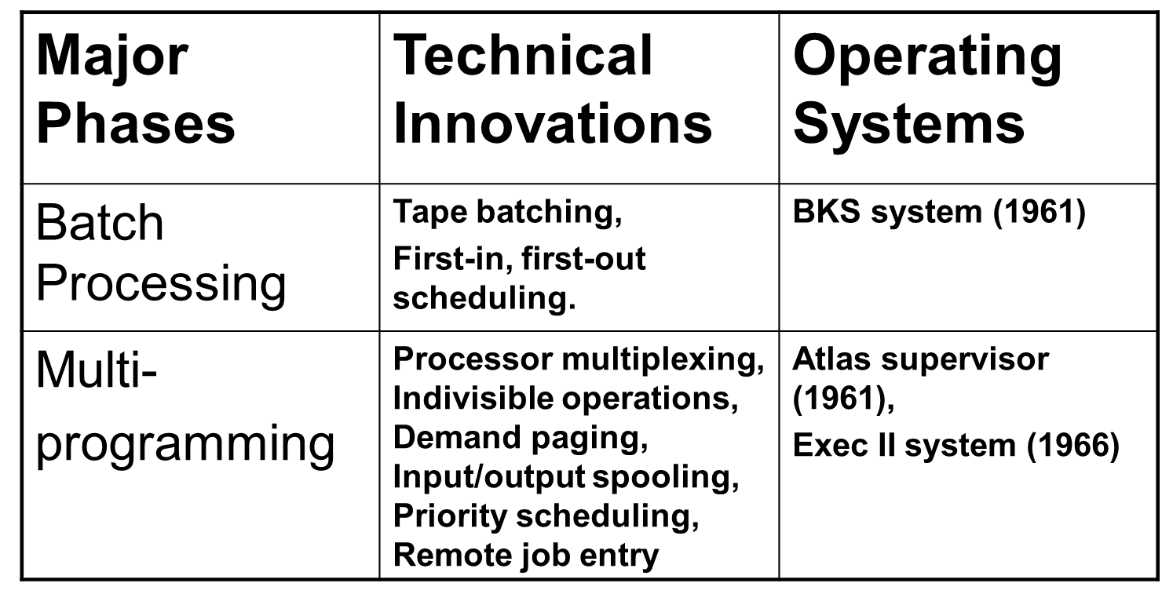

Slide 34
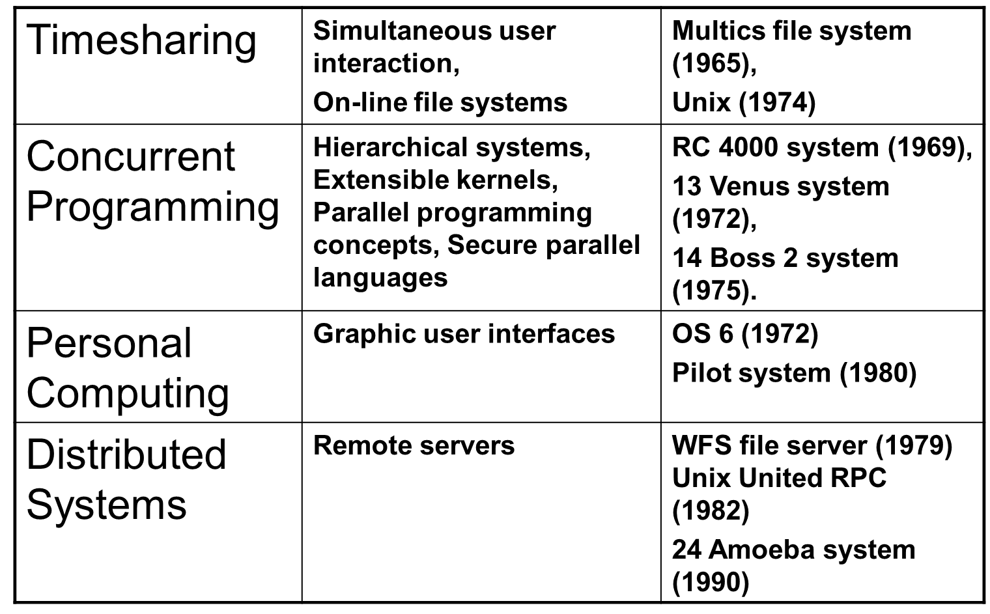

Slide 35
Batch Systems
Batch Operating System
In the era of 1970s, the Batch processing was very popular. The Jobs were executed in batches. People were used to have a single computer which was called mainframe.
In Batch operating system, access is given to more than one person; they submit their respective jobs to the system for the execution.
The system put all of the jobs in a queue on the basis of first come first serve and then executes the jobs one by one. The users collect their respective output when all the jobs get executed.

Slide 36
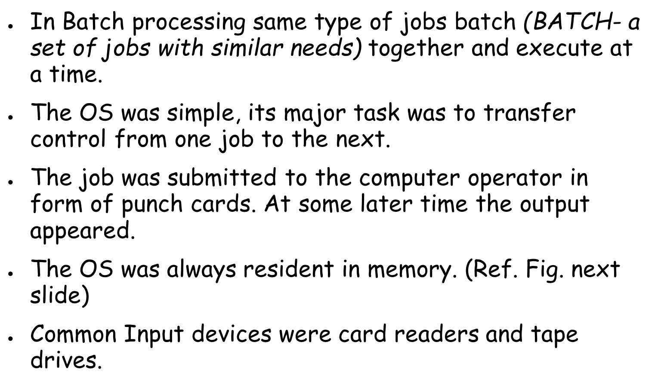
Common output devices were line printers, tape drives, and card punches.
Users did not interact directly with the computer systems, but he prepared a job (comprising of the program, the data, & some control information).

Slide 37
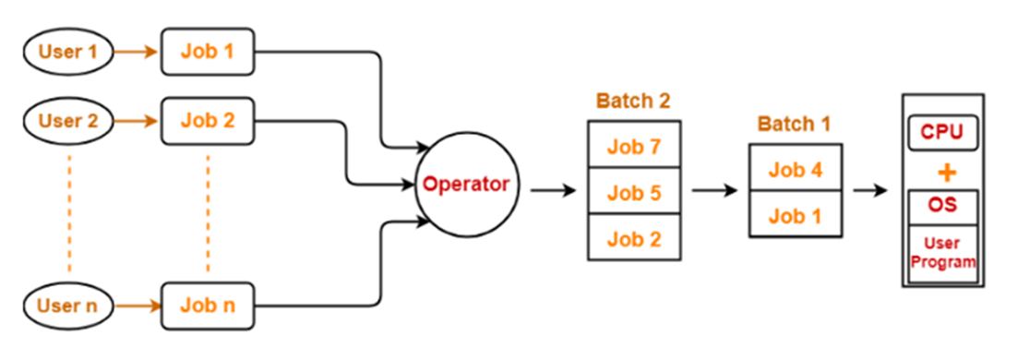
Disadvantages:
1.Efficiency/Throughput: is less, starvation problem
2.Not useful for interactive applications
3. CPU is Idle : CPU utilization is less.

Slide 38
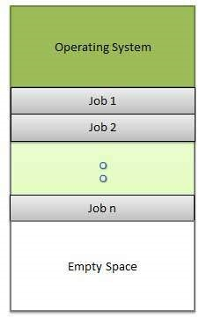
Multi Programmed Systems
Multiprogramming is an extension to the batch processing where the CPU is kept always busy. Each process needs two types of system time: CPU time and IO time.
In multiprogramming environment, for the time a process does its I/O, The CPU can start the execution of other processes. Therefore, multiprogramming improves the efficiency of the system.
Advantages:
Efficient memory utilization
Throughput increases
CPU is never idle, so performance increases.

Slide 39
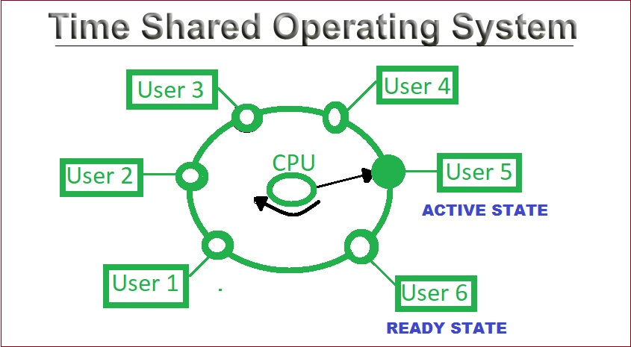
3. Time-Sharing Systems(multitasking).
Batch and Multi-programmed systems provided an environment where system resources are utilized effectively but there is no user interaction with the system.
Time sharing is a logical extension of multiprogramming. The CPU executes multiple jobs by switching among them, but the switches occur so frequently that the users can interact with each program while it is running.
It provides a direct interaction b/w user and system. Time slice is defined by OS for sharing CPU time b/w processes.
It allowed many users to share the computer simultaneously.
This system made the user as it is dedicated completely to the user itself, even though it is being shared among many users.

Slide 40
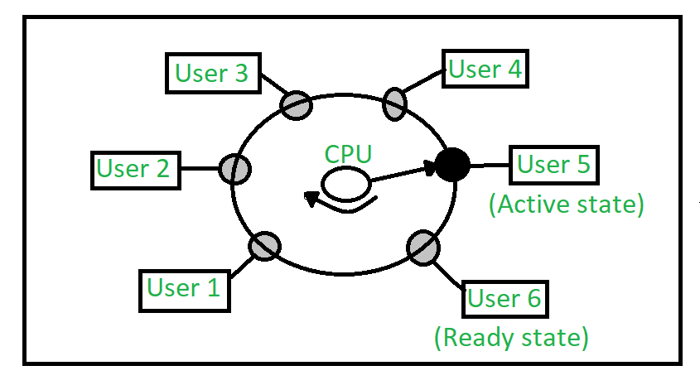
Time Sharing Systems/MultiTasking
A Time shared operating system uses CPU scheduling and multi-programming to provide each with a small portion of a shared computer at once. MultiProgramming with preemption is multitasking
Each user has at least one separate program in memory.
A program loaded into memory and executes, it performs a short period of time either before completion or to complete I/O.
This short period of time during which user gets attention of CPU is known as time slice, time slot or quantum.
CPU is multiplexed among all jobs,so user need not wait. CPU is pulled out in a round robin fashion.
Context switching is so fast, it seems all processes are running in parallel, but true fact is that one process is with CPU at a time.
In above figure the user 5 is active state but user 1, user 2, user 3, and user 4 are in waiting state whereas user 6 is in ready state.

Slide 41
Time sharing, or multitasking, is a logical extension of multiprogramming.
Multiple jobs are executed by switching the CPU between them.
In this, the CPU time is shared by different processes, so it is called as “Time sharing Systems”.
Time slice is defined by the OS, for sharing CPU time between processes.
Examples: Multics, Unix, etc.,

Slide 42
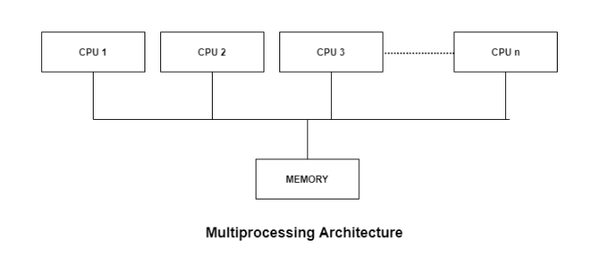
Multiprocessor /Parallel/Tightly coupled Systems
A Multiprocessing operating system (OS) is one in which two or more central processing units (CPUs) control the functions of the computer.
Each CPU contains a copy of the OS, and these copies communicate with one another to coordinate operations.
The use of multiple processors allows the computer to perform calculations faster, since tasks can be divided up between processors.

Slide 43
Multiprocessor /Parallel/Tightly coupled Systems
These are also known as parallel systems or tightly coupled systems.
They have more than one CPU, sharing the Computer bus and clock and sometimes memory and peripherals devices.
The advantages of this system is
a) Increased throughput:
A number of program can be executed in multiprocessor system at a time by sharing the resource.
b) Economy of scale:
These systems can save memory than multiple single processor system, because of sharing mechanism.
c) Increased reliability:
If functions can be distributed among several processors then the failure of one processor will not halt the system, only slow it down, we can execute the function in other processor by sharing the work of the failure processor.

Slide 44
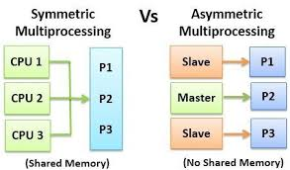
Increased reliability of a computer system is crucial in many applications.
The ability to continue providing service proportional to the level of
surviving hardware is called graceful degradation.
Some systems go beyond graceful degradation and are called fault tolerant, because they can suffer a failure of any single component and still continue operation.
The multiprocessor system today in use is of two types:
Symmetric multiprocessor(SMP): in this each processor performs all tasks within the OS. All processors are peers: no boss-worker relationship exists b/w processors-each having their own set of registers, local or private cache, but shares common memory.
Asymmetric multiprocessor: in this each processor is assigned a specific tasks. A boss processor controls the system; the other processors either look to the boss for instruction or have predefined tasks. This scheme defines a boss-worker relationship i.e., the boss processor schedules and allocates work to the worker processors
OS instance--master

Slide 45
A recent trend in CPU design is to include multiple computing
cores on a single chip. Such multiprocessor systems are termed
as multicore. They are more efficient than multiple chips with single cores because on-chip communication is faster than between-chip communication and it uses less power than multiple single-core chips.
Note: multicore systems are multiprocessor systems, not all multiprocessor systems are multicore
Question to students:
1.What are blade servers?
2. What are clustered systems?

Slide 46
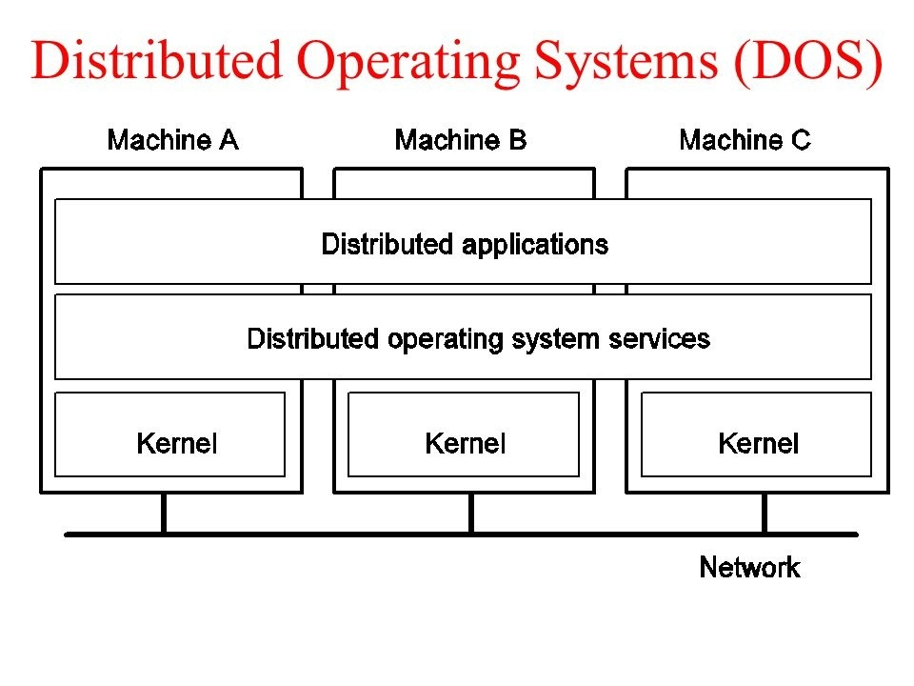
Distributed /Loosely Coupled Systems
It is a modern computer to interconnect groups of PC, batch systems time sharing and real time system.
This has an influence on operating system strategies because of the need for strategy to handle resources and information sharing across the machines interconnected with a network.

Slide 47
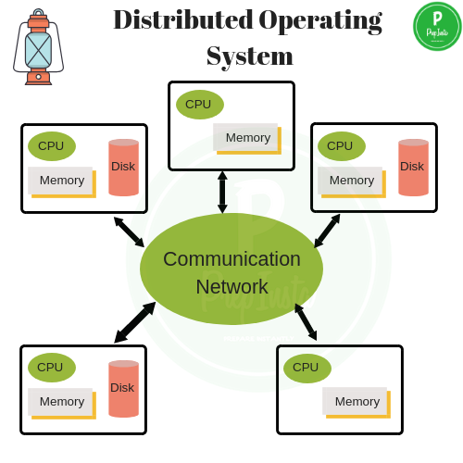
Distributed Systems(referred as loosely coupled systems):
These systems depends on networking, a communication path b/w two or more systems.
Being able to communicate, DS are able to share computational tasks, and provide a rich set of features to users.
Communicate via message passing .
Networks are typecast based on the distance between their nodes.
LAN(within a room, floor or a building)
WAN(b/w buildings, cities or countries)
MAN(link b/w buildings within a city)

Slide 48
Distributed
Client-Server Computing
Many systems now servers, responding to requests generated by clients
Compute-server system provides an interface to client to request services (i.e., database)
File-server system provides interface for clients to store and retrieve files

Slide 49
Computing Environments - Peer-to-Peer
Another model of distributed system
P2P does not distinguish clients and servers
Instead all nodes are considered peers
May each act as client, server or both
Node must join P2P network
Registers its service with central lookup service on network, or
Broadcast request for service and respond to requests for service via discovery protocol
Examples include Napster and Gnutella, Voice over IP (VoIP) such as Skype

Slide 50
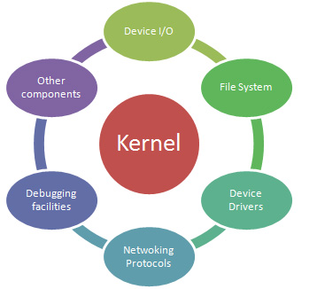
Real Time Systems
A Real-time system is defined as a data processing system in which the time interval required to process and respond to inputs is so small that it controls the environment.
The time taken by the system to respond to an input and display of required updated information is termed as the response time.
Real-time systems are used when there are rigid time requirements on the operation of a processor or the flow of data and real-time systems can be used as a control device in a dedicated application.
A real-time operating system must have well-defined, fixed time constraints, otherwise the system will fail. It is of two types
Hard real time system: - It guarantees that critical tasks can be completed on time.
Soft real time system: - In this a critical real-time task gets priority over other tasks and retains that priority until it completes.within time interval task needs to be completed.
Example: military, missile launching, medical,NASA

Slide 51
Computer system Organization
The Three components are:-
1.Computer-System Operation
2.Storage Structure
3.I/O Structure

Slide 52
Computer system Organization
1.Computer-System Operation
A Modern computer system

Slide 53
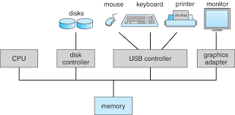
Computer-System Organization
Computer-System Operation:
A modern general-purpose computer system consists of
one or more CPUs
Number of device controllers connected through
a common bus that provides access to shared memory
Each type of device controller is in charge of a specific
Device controller. CPU and device controllers can execute in parallel , competing for memory cycles.
To ensure orderly access to the shared memory, memory controller synchronizes access to the memory

Slide 54
Computer system Organization
One or more CPUs, device controllers connect through common bus providing access to shared memory
Depends on the point of view – Users want convenience, ease of use – System managers and owners want efficiency use of resources such as CPU use of resources such as CPU time, memory, and storage; ultimately saving money and serving business
Bootstrap program is loaded at power-up or reboot – Typically stored in ROM or EPROM, generally known as known as firmware.

Slide 55
Bootstrap program:
When a system is powered up or rebooted, it needs to
have an initial program to run. It is stored within the computer hardware in ROM or in EPROM(called firmware).
It initializes all aspects of the system, from CPU registers to device controllers to memory contents.
The Bootstrap program must know how to load the OS and how to start the Computer system.
To do this, program must locate the OS kernel and load into memory.
Once it is loaded and executing, it can start providing services to the system and the users. Some services are provided outside the kernel by processes or System daemons(processes that run background).
On Unix, the first system program is “init”-it starts many other daemons

Slide 56
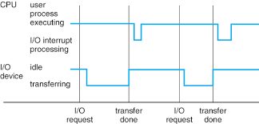
Execution of a process:
Once the system is fully booted, the system
waits for an event to occur, this event is usually
signaled by an interrupt either from s/w or from h/w.
H/w may trigger an interrupt at any time by
sending signal to the CPU.
S/w may trigger an interrupt by executing a
special operation called a System Call(monitor call).
When the CPU is interrupted, it stops executing what it is doing and immediately transfers execution to a fixed location . This location contains the starting address where the service routine for the interrupt is located.
The interrupt service routine executes; on completion, CPU resumes the interrupted computation.

Slide 57
Computer system Organization
I/O devices and the CPU can execute in parallel
Each device controller is in charge of a particular device type
Each device controller has a local buffer .
CPU moves data from/to main memory to/from local buffers.
I/O is from the device to local buffer of controller .
Device controller informs CPU that it has finished its operation by causing an interrupt (e.g., by setting the interrupt bit in a register)

Slide 58
Computer system Organization
Interrupt transfers control to the interrupt service routine generally, through the interrupt vector, which contains the addresses of all the service routines
Interrupt architecture must save the address of Interrupt architecture must save the address of the interrupted instruction
An operating system is interrupt driven.
The operating system preserves the state of the CPU by storing registers and the program counter .
Determines which type of interrupt has occurred (e.g., check interrupt register)
Separate segments of code determine what action should be taken for each type of interrupt.

Slide 59
Computer system Organization
An interrupt time line for a single process doing output

Slide 60
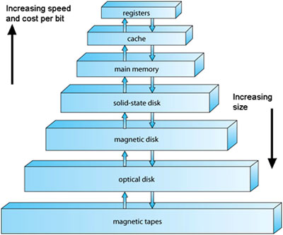
Computer system Organization
2. Storage Structure
Storage-Device hierarchy

Slide 61
Storage Structure
The CPU can load instructions only from memory, any program to run must be stored in memory.
ROM contains only static programs which cannot be changed(Bootstrap).
Computer run most of their programs from rewritable memory called main memory(RAM).
The system wants the programs and data to reside in main memory permanently
Main memory is too small to accommodate space to programs and data
It is a volatile storage device that loses its contents when power is turned off.

Slide 62
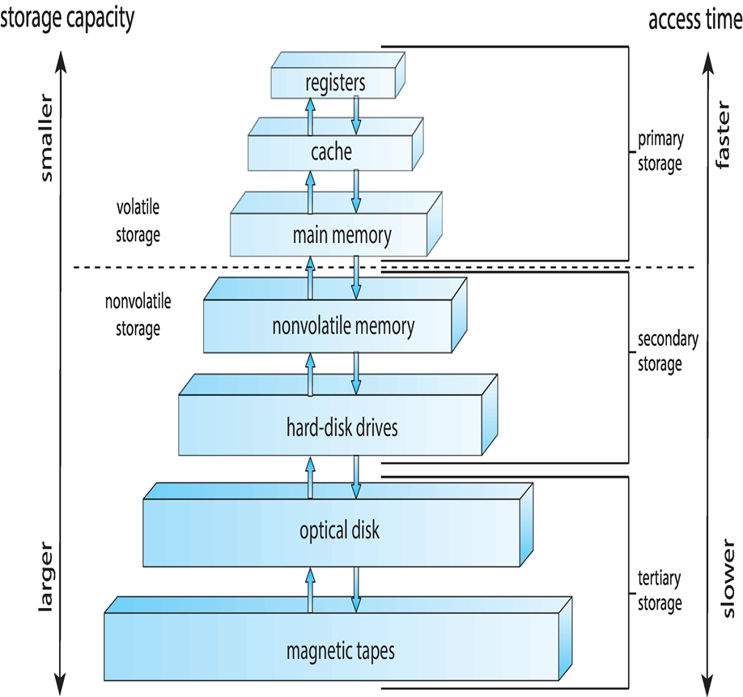
Storage Structure
Most computer provide secondary storage as an extension of main memory-magnetic disks(holds large volume od data permanently).
Storage system can be organized in a hierarchy according to speed and cost.
The higher levels are expensive but fast.
As we move down the cost per bit decreases but access time increases

Slide 63
Computer system Organization
Main memory – only large storage media that the CPU can access directly
Random access
Typically volatile
Secondary storage – extension of main memory that provides large nonvolatile storage capacity
Hard disks – rigid metal or glass platters covered with magnetic recording material
Disk surface is logically divided into tracks, which are subdivided into sectors
The disk controller determines the logical interaction between the device and the computer
Solid-state disks – faster than hard disks, nonvolatile
Various technologies
Becoming more popular
General Purpose computers run most of their programs from rewritable memory, called main memory(also called RAM or Random access memory).
Main Memory commonly is implemented in a semi conductor technology called Dynamic RAM(DRAM).
Computers use other forms of memory as well. Because the read-only memory(ROM) cannot be changed ,only static programs are stored there.
Generally we want to store the programs and data in main memory but this is not possible because:-
1.Main memory is usually too small to store all needed programs and data permanently.
2. Main Memory is a volatile storage device that loses its contents where power is turned off or otherwise lost.

Slide 64
Computer system Organization
Most computers systems provide secondary storage as an extension of main memory. The main requirement for secondary storage is that it will be able to hold large quantities of data permanently.
The most common secondary- storage device is a Magnetic disk.
Volatile storage loses it contents when the power to the device removed so data must be written to non-volatile storage
An Electronic disk can be volatile or non-volatile. Another form of electronic disk is Flash memory, which is popular in cameras and Personal digital assistants(PDA’s) in robots. Storage systems organized in hierarchy
Speed
Cost
Volatility
Size
Caching – copying information into faster storage system; main memory can be viewed as a cache for secondary storage
Device Driver for each device controller to manage I/O
Provides uniform interface between controller and kernel

Slide 65
Caching
Important principle, performed at many levels in a computer (in hardware, operating system, software)
Information in use copied from slower to faster storage temporarily
Faster storage (cache) checked first to determine if information is there
If it is, information used directly from the cache (fast)
If not, data copied to cache and used there
Cache smaller than storage being cached
Cache management important design problem
Cache size and replacement policy

Slide 66
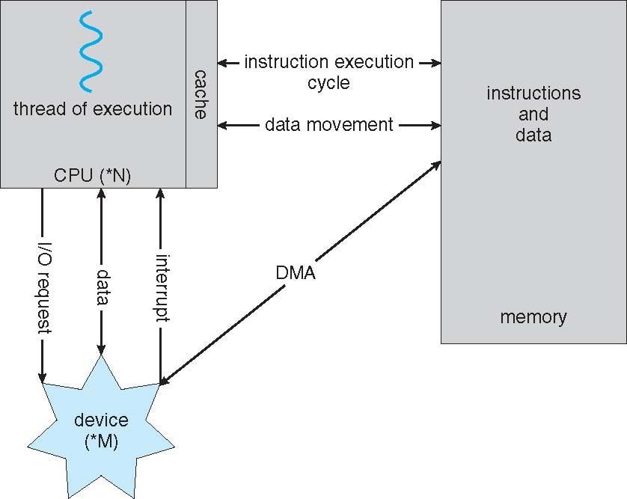
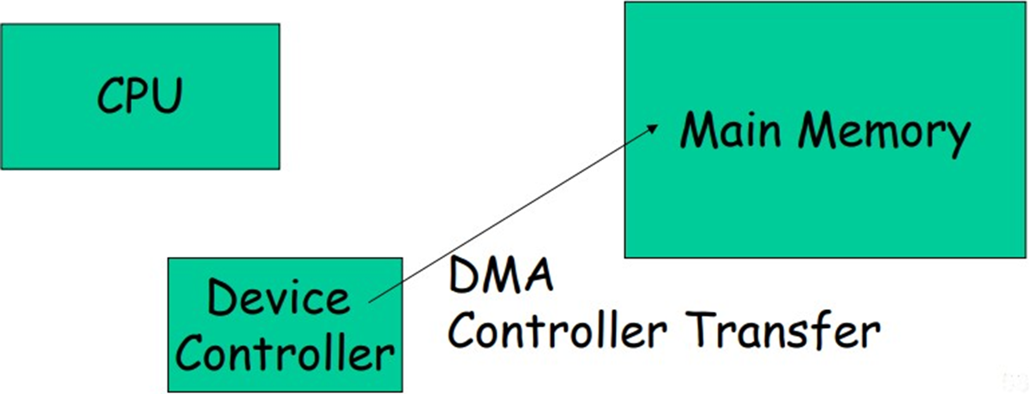
Direct Memory Access Structure
Used for high-speed I/O devices able to transmit information at close to memory speeds
Device controller transfers blocks of data from buffer storage directly to main memory without CPU intervention
Only one interrupt is generated per block, rather than the one interrupt per byte

Slide 67
Computer system Organization
3.I/O Structure
After I/O starts, control returns to user program only upon I/O completion (e.g., keyboard input, or reading file from disk) .
The user program is taken off the CPU – When the I/O is complete, the device (keyboard, or disk controller) sends an interrupt to the OS – The OS saves the current process, handles the interrupt, the system continues …
Direct Memory Access (DMA)
Device controller transfers blocks of data from buffer storage directly to main memory without CPU intervention, once a request is received request is received.

Slide 68
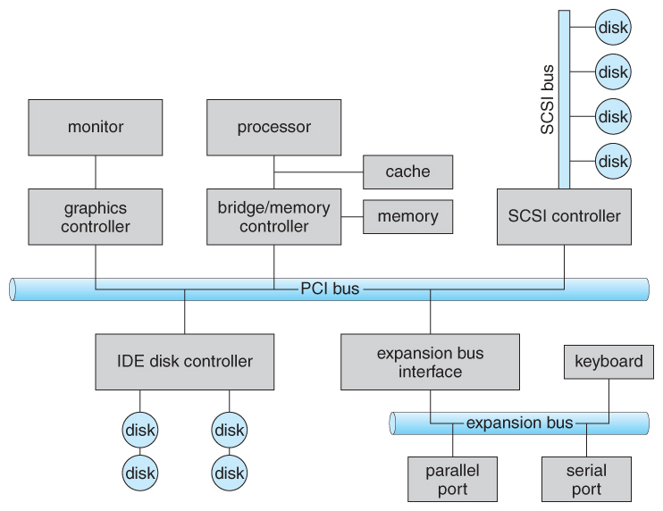
I/O Structure

Slide 69
I/O Subsystem

Slide 70
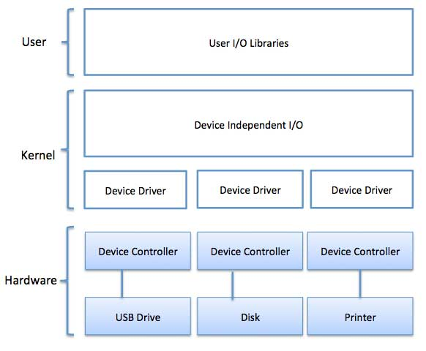
I/O Subsystem

Slide 71
Computer System Architecture
The Architecture consists of 3 components
1 Single –Processor Systems
2. Multiprocessor Systems
3.Clustered systems

Slide 72
Single –Processor Systems
Most systems use a single processor. a single-processor system, there is one main CPU capable of executing a general-purpose instruction set, including instructions from user processes.
Almost all systems have other special-purpose processors as well. They may come in the form of device-specific processors, such as disk, keyboard, and graphics controllers or on mainframes, they may come in the form of more general-purpose processors, such as I/O processors that move data rapidly among the components of the system.
All of these special-purpose processors run a limited instruction set and do not run user processes.
Sometimes they are managed by the operating system, in that the operating system sends them information about their next task and monitors their status

Slide 73
Multiprocessor Systems
Multiprocessor systems (also known as parallel systems or tightly coupled systems) are growing in importance. Such systems have two or more processors in close communication, sharing the computer bus and sometimes the clock, memory, and peripheral devices.
Multiprocessor systems have three advantages:
1. Increased throughput: Number of jobs done in a unit time
2. Economy of scale. Multiprocessor systems can cost less than equivalent multiple single-processor systems, because they can share peripherals, mass storage, and power supplies.
3.Increased reliability. If functions can be distributed properly among several processors, then the failure of one processor will not halt the system, only slow it down. graceful degradation or fault tolerance.
Used when high speed is required to process large volume of data, Example. Weather forecast,satellite communication, to increase computing power.

Slide 74
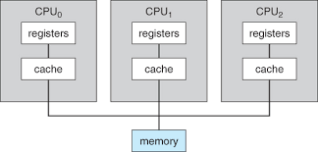
Multiprocessor Systems
The multiple-processor systems in use today are of two types. 1. Asymmetric multiprocessing, which each processor is assigned a specific task.Master Slave relationship exists.Only one instance of CPU is running which is master which will be performing CPU operation while the remaiing CPU’s(Slaves) will perform I/O Operation.
2. Symmetric multiprocessing (SMP), The most common systems use in which each processor performs all tasks within the operating system.
No Master slave relationship. Each CPU is given equal priority.

Slide 75
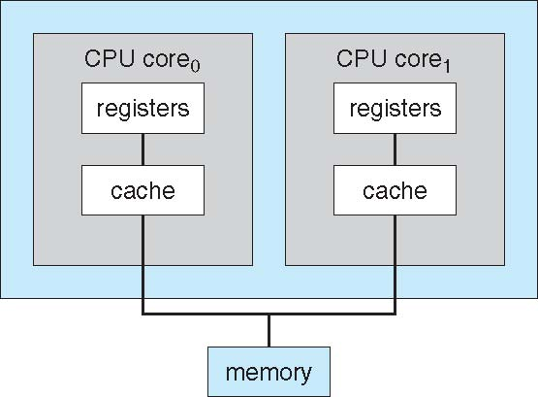
A Dual-Core Design
Multi-chip and multicore
Systems containing all chips
Chassis containing multiple separate systems

Slide 76
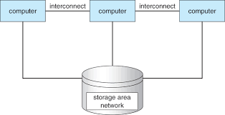
Clustered systems
Clustered system is an another type of multiple-CPU system. Clustered systems differ from multiprocessor systems, however, in that they are composed of two or more individual systems coupled together.
Clustering is usually used to provide high-availability service; that is, service will continue even if one or more systems in the cluster fail. Clustering can be structured asymmetrically or symmetrically. Cluster technology is changing rapidly.

Slide 77
Like multiprocessor systems, but multiple systems working together
Usually sharing storage via a storage-area network (SAN)
Provides a high-availability service which survives failures
Asymmetric clustering has one machine in hot-standby mode
Symmetric clustering has multiple nodes running applications, monitoring each other
Some clusters are for high-performance computing (HPC)
Applications must be written to use parallelization
Some have distributed lock manager (DLM) to avoid conflicting operations.
Software cluster: allows all systems to work together.
Hardware cluster: to alow high performance disk sharing among systems.

Slide 78
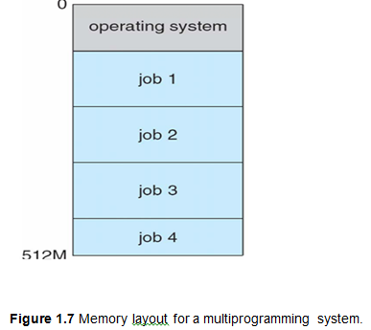
Operating System Structure
An operating system provides the environment within which programs are executed. One of the most important aspects of operating systems is the ability to multiprogram.
A single user cannot, in general, keep either the CPU or the I/O devices busy at all times. Multiprogramming increases CPU utilization by organizing jobs (code and data) so that the CPU always has one to execute.
The operating system keeps several jobs in memory simultaneously
One job selected and run via job scheduling
When it has to wait (for I/O for example), OS switches to another job

Slide 79
Operating System Structure
Time sharing (or multitasking) is a logical extension of multiprogramming. In time-sharing systems, the CPU executes multiple jobs by switching among them, but the switches occur so frequently that the users can interact with each program while it is running creating interactive computing
Time sharing requires an interactive (or hands-on) computer system, which provides direct communication between the user and the system. A time-shared operating system allows many users to share the computer simultaneously.
Each user has at least one program executing in memory process
If several jobs ready to run at the same time  CPU scheduling
If processes don’t fit in memory, swapping moves them in and out to run
Virtual memory allows execution of processes not completely in memory

Slide 80

Operating System Operations
Interrupt:
Device sends a special signal to CPU when data arrives.
“Wake me up when we get there.”
Responds to hardware interrupt signal by interrupting current processing.
Now CPU can perform tasks before and after interrupt instead of just polling.
Department of CSE, GIT
19ECS204:Operating System

Slide 81
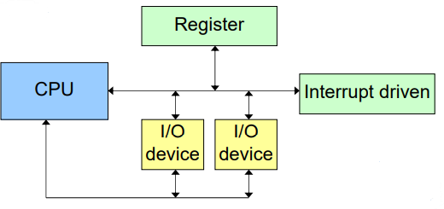
General Interrupt Flow
Completes current instruction.
Saves current state to status register.
Identify source.
Jump to and activate Interrupt Service Routing (ISR).
Return to original program (RTI) and restore state
Department of CSE, GIT
19ECS204:Operating System

Slide 82
Types of interrupts
Ignorable interrupts (or Maskable)
Most often used
Good for using when computer needs to do something more important
When the interrupt mask is set, interrupts are hidden and therefore are ignored.
Non-ignorable interrupts (Non-maskable)
NMI’s take precedence and interrupt any task
Department of CSE, GIT
19ECS204:Operating System

Slide 83
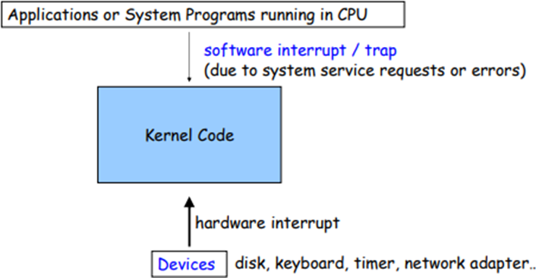
Operating System Operations
Interrupt driven is modern operating systems.
Events are signaled by the occurrence of an interrupt or a trap.
Hardware interrupt by one of the devices
Software interrupt (exception or trap):
Software error (e.g., division by zero) or invalid memory access
Request for operating system service from a user program---system call
Other process problems include infinite loop, processes modifying each other or the operating system
The interrupt-driven nature of an operating system defines that system's general structure.
For each type of interrupt, separate segments of code in the operating system determine what action should be taken.
The OS and the Users share the h/w and s/w resources available in the system, and we make sure that an error in a user program could cause problems only for the one program running, b’coz with multiprogramming system, when error in one program might not cause problem to other programs or data or OS.
A properly designed OS must ensure that an incorrect(or malicious) program cannot cause other programs to execute incorrectly.

Slide 84
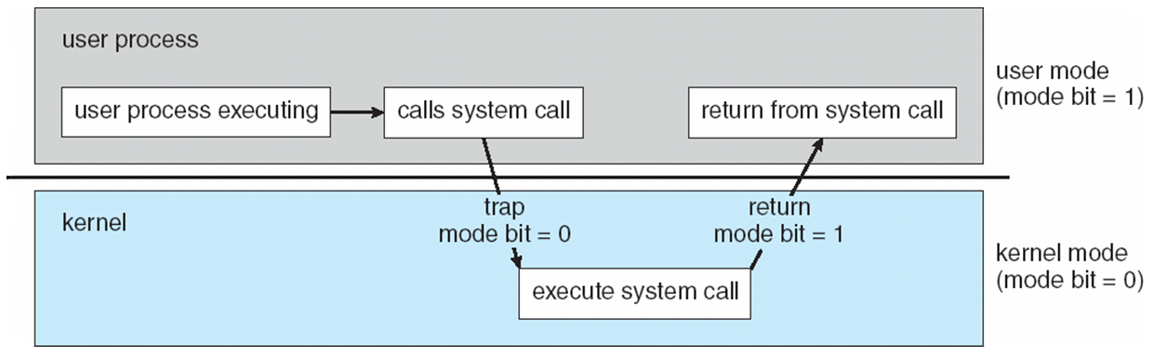
Dual-mode and Multimode Operations: An error in one program can
adversely affect many processes, it might modify data of another program, or also can affect the operating system. For example, if a process stuck in infinite loop then this infinite loop could affect correct operation of other processes. So to ensure the proper execution of the operating system, there are two modes of operation:
User mode – When the computer system run user applications like creating a text document or using any application program, then the system is in the user mode. When the user application requests for a service from the operating system or an interrupt occurs or system call, then there will be a transition from user to kernel mode to fulfill the requests. The mode bit is set to 1 in the user mode. Note: To switch from user mode to kernel mode, mode bit is set to 0, after completion the mode bit is set to 1 to switch to user mode
Kernel Mode(supervisor mode, system mode or privileged mode) – When the system boots, hardware starts in kernel mode and when operating system is loaded, it start user application in user mode. To provide protection to the hardware, we have privileged instructions which execute only in kernel mode. If user attempt to run privileged instruction in user mode then it will treat instruction as illegal and traps to OS. Some of the privileged instructions are:
Handling Interrupts
To switch from user mode to kernel mode.
Input-Output management.
.

Slide 85
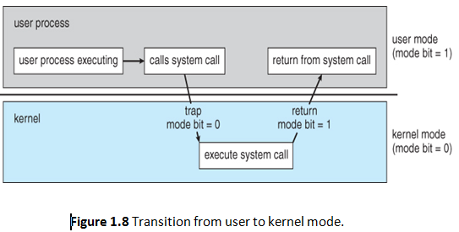
Operating system operations
1 . Dual-mode operation allows OS to protect itself and other system components
Two separate modes of operation: user mode and kernel mode (also called supervisor mode, system mode, or privileged mode).
A bit, called the mode bit, is added to the hardware of the computer to indicate the current mode: kernel (0) or user (1). The dual mode of operation provides us with the means for protecting the operating system from errant users—and errant users from one another.
The hardware allows privileged instructions to be executed only in kernel mode.
If an attempt is made to execute a privileged instruction in user mode, the hardware does not execute the instruction but rather treats it as illegal and traps it to the operating system.

Slide 86
Operating System Operations
2 Timer
Timer to prevent infinite loop / process hogging resources
Timer is set to interrupt the computer after some time period
Keep a counter that is decremented by the physical clock.
Operating system set the counter (privileged instruction)
When counter zero generate an interrupt
Set up before scheduling process to regain control or terminate program that exceeds allotted time

Slide 87
TIMER
OS is called as Control program, it should maintain control over CPU.
Never allowing a user program to get stuck in an infinite loop or fail to call system services and never return control to OS are one of the goals of OS. To accomplish this, a TIMER is included in the system.
A timer can be set to interrupt the computer after a specified period. It can be fixed or variable timer.
A timer A technique is used to initialize a counter with the amounis used to prevent a user program from running too long.
t of time that a program is allowed to run.
Example: if a program is given 7-minute time limit, with a counter 420, every second the timer interrupts and the counter decrements by 1, as long as counter is positive control is returned to the user program, once counter value becomes negative, the OS terminates the user program by aborting it due to exceed time limit.

Slide 88
Modern OS should have the following concepts
To manage the resources(CPU,Memory,files etc) OS holds the abstraction of each resources and coordinates with the help of
Process management/ Thread management
Main Memory Management
File Management
Secondary Storage Management
I/O System Management
Networking
Protection System
Operating System is a large and complex system so it is portioned into small pieces each perform its own task. When the user interacts with OS behalf of it, it performs the above following functions.

Slide 89
Process Management
A process is a program in execution. It is a unit of work within the system. Program is a passive entity, process is an active entity.
Process needs resources to accomplish its task
CPU, memory, I/O, files
Initialization data
Process termination requires reclaim of any reusable resources
Single-threaded process has one program counter specifying location of next instruction to execute
Process executes instructions sequentially, one at a time, until completion
Multi-threaded process has one program counter per thread
Typically system has many processes, some user, some operating system running concurrently on one or more CPUs
Concurrency by multiplexing the CPUs among the processes / threads

Slide 90
Representation of process
Process has one program counter specifying location of next instruction to execute
Data structure (stores information of a process)
Many processes may be associated with the same program
Typically system has many processes
some user processes,
some operating system processes
Life cycle of a process
States
Arrival, Computation, I/O, I/O completion, termination

Slide 91
Process Management
The operating system is responsible for the following activities in connection with Process Management
Scheduling processes and threads on the CPUs.
Creating and deleting both user and system processes.
Suspending and resuming processes.
Providing mechanisms for process synchronization.
Providing mechanisms for process communication.

Slide 92
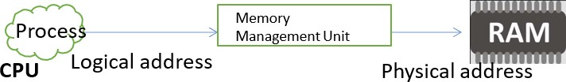
Main Memory Management
Main Memory is the central to the operation of a modern computer system.
Memory Management is an essential function of the Operating System. This comes under one of the two main functions of an Operating System, resource management. Main memory (RAM) is where most of the applications run
All instructions and data in memory in order to execute
Translate the logical address to physical address
The jobs of memory management include:-
Keeping track of which parts of memory are currently being used and by whom
Deciding which processes (or parts thereof) and data to move into and out of memory
Allocating and deallocating memory space as needed
Free up the memory after the processes have used it.

Slide 93
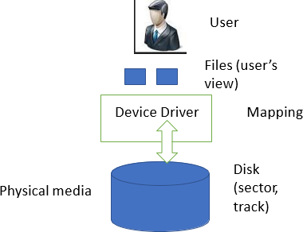
Storage Management
OS provides uniform, logical view of information storage
Abstracts physical properties to logical storage unit - file
File => Collection of related information defined by the creator
Each medium is controlled by device (i.e., disk drive, tape drive)
Varying properties include access speed, capacity, data-transfer rate, access method (sequential or random)
The main components of storage management are:-
1. File-System Management
2.Mass-Storage Management
3. Caching
4.I/O Systems

Slide 94
Storage Management
1. File-System Management
Files usually organized into directories
Access control on most systems to determine who can access what
OS activities include
Creating and deleting files and directories
Primitives to manipulate files and directories
Mapping files onto secondary storage
Backup files onto stable (non-volatile) storage media
2.Mass-Storage Management
Usually disks used to store data that does not fit in main memory or data that must be kept for a “long” period of time
Proper management is of central importance
Entire speed of computer operation hinges on disk subsystem and its algorithms
OS activities
Free-space management
Storage allocation(logical blocks)
Disk scheduling

Slide 95
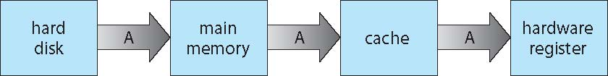
Storage Management
Some storage need not be fast
Tertiary storage includes optical storage, magnetic tape
Still must be managed – by OS or applications
Varies between WORM (write-once, read-many-times) and RW (read-write)
3. Caching:-important principle of cimputer system.
Migration of data “A” from Disk to Register
Multitasking environments must be careful to use most recent value, no matter where it is stored in the storage hierarchy Multiprocessor environment must provide cache coherency in hardware such that all CPUs have the most recent value in their cache
By OS
By Hardware

Slide 96
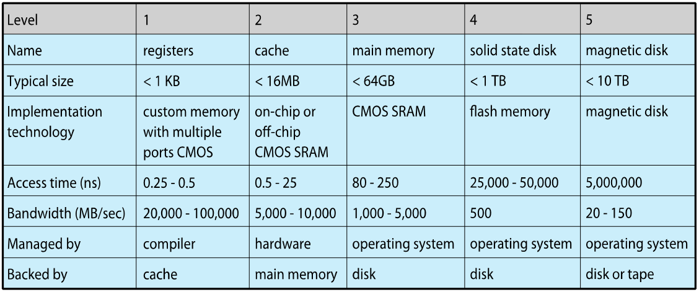
Performance of Various Levels of Storage
Movement between levels of storage hierarchy can be explicit or implicit

Slide 97
Storage Management
4.I/O Systems:-
One purpose of OS is to hide peculiarities of hardware devices from the user
I/O subsystem responsible for
Memory management of I/O including buffering (storing data temporarily while it is being transferred), caching (storing parts of data in faster storage for performance), spooling (the overlapping of output of one job with input of other jobs)
General device-driver interface
Drivers for specific hardware devices

Slide 98
Protection and Security
Protection – has to do with authorization i.e., any mechanism for controlling access of processes or users to resources defined by the OS.
It means being able to distinguish between authorized and unauthorized access. E.g. user-id/password, smart cards with biometrics data, Multi-factor authorization (MFA) etc.
A system can have adequate protection (authorization) and still be prone to failure and inappropriate access (e.g. if a user’s userid/password is stolen). Then data can be copied or deleted.

Slide 99
Protection and Security
Security – It is the job of security to defend a system against internal and external attacks.
Huge range, including denial-of-service, worms, viruses, identity theft, theft of service
While defending against some of these attacks may be considered to be an O/S function on some systems, it is left to specialized software on other systems (viruses, malware etc.) such as Norton’s Security Suite.

Slide 100
Kernel Data Structures:
Kernel is the heart of the OS-central to OS implementation.
Lists , Stacks, And Queues:
An array is a simple data structure in which each element is accessed directly.
Example: If main memory is constructed as an array with each of size 1 byte, and if a data/item being stored is larger than 1 byte, then to store it needs multiple bytes and the item is addressed as item number X item size. But if the item size varies , in that situation there is a need to implement other data structures.
After arrays, lists are the most fundamental DS in CS-where each item in an array can be accessed directly in a linear fashion. Disadvantage is it needs more memory space for a node, each node contains item and the address of the next node and to access a particular item needs to traverse the list until that item is found.

Slide 101
Kernel Data Structures
Many similar to standard programming data structures
Singly linked list
Doubly linked list
Circular linked list

Slide 102
Stacks and Queues:
1. Stack: It is a sequentially ordered list of DS that uses the LIFO principle for adding and removing of the data.
The operations used to add and remove an item is PUSH and POP.
An OS uses stack when invoking a System calls- Parameters, Local variables and return addresses are pushed into stack when a function is called; returning from the function call pops these items from the stack
2. Queue: it is a sequentially ordered DS that uses the FIFO principle.
Items are added at rear end and removed from front end.
Example: Printer

Slide 103
Kernel Data Structures
Binary search tree left <= right
Search performance is O(n)
Balanced binary search tree is O(lg n)

Slide 104
Trees:
A tree is a DS that can be used to represent data in a hierarchical way.
Data items in a tree structure are linked through parent-child relationship.
Parent may have an unlimited no. of children.
In binary tree, a parent may have atmost 2 children. Which we term left child and right child
In binary search tree. Additionally requires an ordering b/w parent’s two children in which left_child <=right_child.

Slide 105
Kernel Data Structures
Hash function can create a hash map
Bitmap – string of n binary digits representing the status of n items
Linux data structures defined in
include files <linux/list.h>, <linux/kfifo.h>, <linux/rbtree.h>

Slide 106
Hash functions:
In this DS a hash function takes data as i/p, performs a numeric operation on this data and returns a numeric value.
This numeric value can then be used as an index into a page table to quickly retrieve the data.
Disadvantage is , if two i/p’s results the same o/p i.e, if they link to same index location that contains all of the items with the same hash value then collision occurs(called as hash collision).
One way to address this is implementing a hash map which contains a key value.

Slide 107
Hash functions:
In this DS a hash function takes data as i/p, performs a numeric operation on this data and returns a numeric value.
This numeric value can then be used as an index into a page table to quickly retrieve the data.
Disadvantage is , if two i/p’s results the same o/p i.e, if they link to same index location that contains all of the items with the same hash value then collision occurs(called as hash collision).
One way to address this is implementing a hash map which contains a key value.

Slide 108
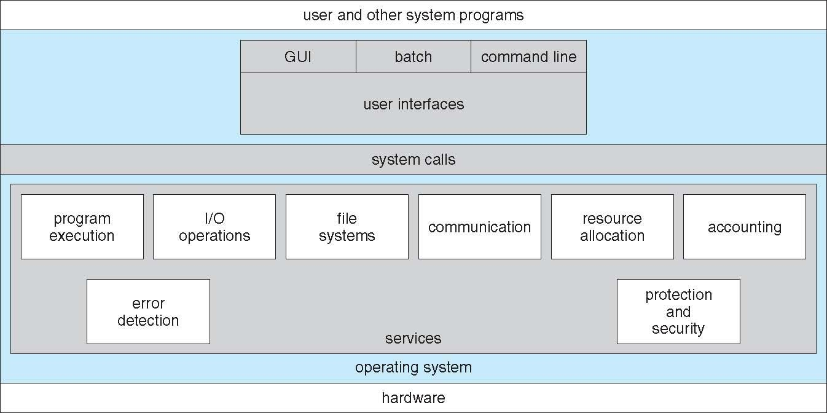
A View of Operating System Services
26 January 2022
Department of CSE, GIT
19ECS204:Operating System

Slide 109
Operating System Services
An OS provides an environment for the execution of programs. To make the programming task easier, the OS provides services like,
1) Program Execution :
The system must load program into memory and to run that program. This program must be able to end its execution either normally or abnormally(indicate error).
2) I/O Operation :
A running program may require I/O operation. This I/O may be a file or an I/O device. For efficiency and protection, users cannot control I/O devices directly. Therefore OS must provide a means to do I/O.
3) File System manipulations:
Program need to read and write files. It also need to create and delete file by name.Permissions to a file-view,append

Slide 110
Operating System Services
4) Communications :
In some cases, one process needs to exchange information with another process i.e., processes that are executing on different computer systems tied together by a computer network. Communications may be implemented via shared memory or through message passing, in which packets of information are moved between processes by the operating system.
5) Error Detection :
The operating system needs to be constantly aware of possible errors. Errors may occur in the CPU and memory hardware (such as a memory error or a power failure), in I/O devices (such as a parity error on tape, a connection failure on a network, or lack of paper in the printer), and in the user program (such as an arithmetic overflow, an attempt to access an illegal memory location, or a too-great use of CPU time). For each type of error, the operating system should take the appropriate action to ensure correct and consistent computing.

Slide 111
Operating System Services
6) Resource allocation :
When there are multiple users or multiple jobs running at the same time, resources must be allocated to each of them. Many different types of resources are managed by the operating system.Some (such as CPU cycles, main memory, and file storage) may have special allocation code, whereas others (such as I/O devices) may have much more general request and release code.
7) Accounting :
The OS should keep track of information like which users use how many and what type of resources.
8) Protection:
The owners of information stored in a multiuser or networked computer system may want to control use of that information. Protection ensures that all access to system resources is controlled. Security ensures authentication by means of password.e of resources.

Slide 112
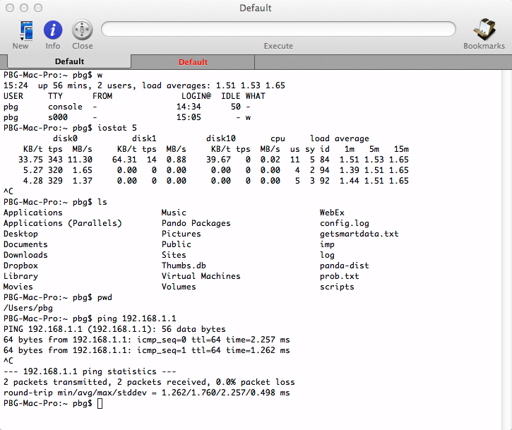
User Operating System Interface
CLI or command interpreter allows direct command entry
Sometimes implemented in kernel, sometimes by systems program
Sometimes multiple flavors implemented – shells
Primarily fetches a command from user and executes it.
The main function of the command interpreter is to get and execute the next user-specified command.
Sometimes commands built-in, sometimes just names of programs
If the latter, adding new features doesn’t require shell
modification
26 January 2022
Department of CSE, GIT
19ECS204:Operating System

Slide 113
User Operating System Interface
GUI(Graphical User Interface) :-User-friendly desktop metaphor interface
Usually mouse, keyboard, and monitor
Icons represent files, programs, actions, etc
Various mouse buttons over objects in the interface cause various actions (provide information, options, execute function, open directory (known as a folder)
Invented at Xerox PARC
Many systems now include both CLI and GUI interfaces
Microsoft Windows is GUI with CLI “command” shell
Apple Mac OS X is “Aqua” GUI interface with UNIX kernel underneath and shells available
Unix and Linux have CLI with optional GUI interfaces (CDE, KDE, GNOME)
26 January 2022
Department of CSE, GIT
19ECS204:Operating System

Slide 114
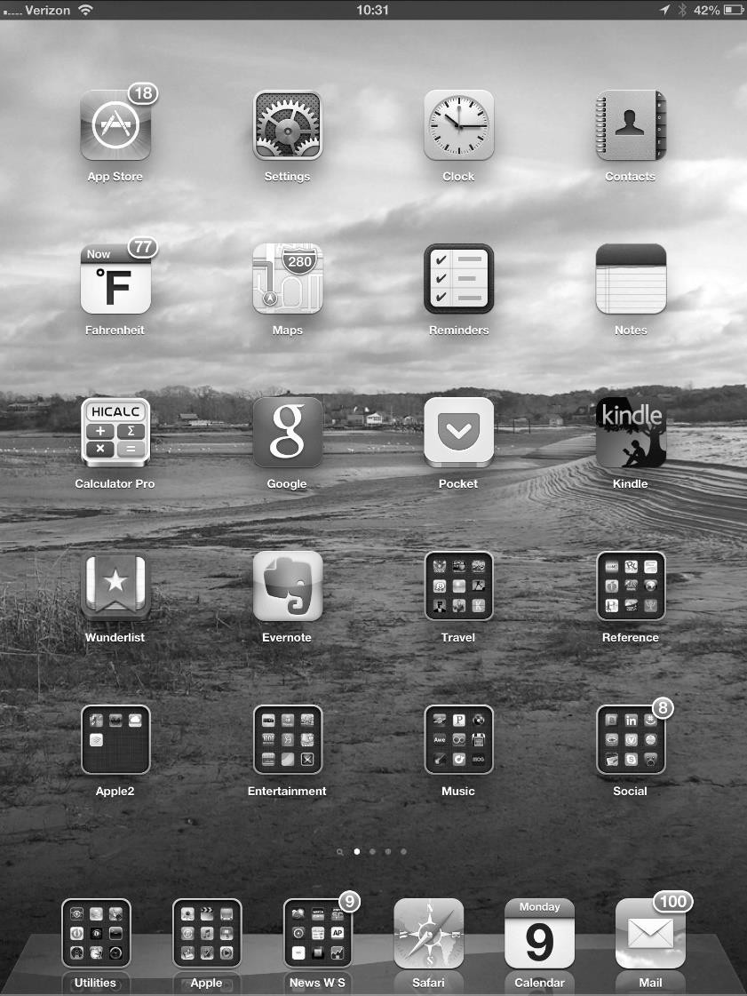
User Operating System Interface
Touchscreen devices require new
interfaces
Mouse not possible or not desired
Actions and selection based on gestures
Virtual keyboard for text entry
Voice commands.
26 January 2022
Department of CSE, GIT
19ECS204:Operating System

Slide 115
System Calls
System calls provide an interface to the services made availability by an operating system.
These calls are generally available as routines written in C and C++, although certain low level tasks may need to be written using assembly-language instructions.
Typically written in a high-level language (C or C++)
Mostly accessed by programs via a high-level Application Programming Interface (API)
rather than direct system call use
Three most common APIs are Win32 API for Windows, POSIX API for POSIX-based systems (including virtually all versions of UNIX, Linux, and Mac OS X), and Java API for the Java virtual machine (JVM)
26 January 2022
Department of CSE, GIT
19ECS204:Operating System

Slide 116
System Calls
Lets first use an example to illustrate how system calls are used: Writing a simple program to read data from one file and copy them to another file .
The first input that the program will need is the names of the two files: Input file and output file.
One approach is for the program to ask the user for the names of the two files.
In an interactive system , this approach will require a sequence of system calls , first to write a prompting message on the screen and then to read from the keyboard the characters that define the two files.
On Mouse-based and icon –based systems, a menu of files names is usually displayed in a window.
The user can then use the mouse to select the source name , and a window can de opened for
the destination name to be specified . This sequence requires many I/O System calls.
Once the two file names are obtained, the program must open the input file and create the output file . Each of these operations requires another system call.
26 January 2022
Department of CSE, GIT
19ECS204:Operating System

Slide 117
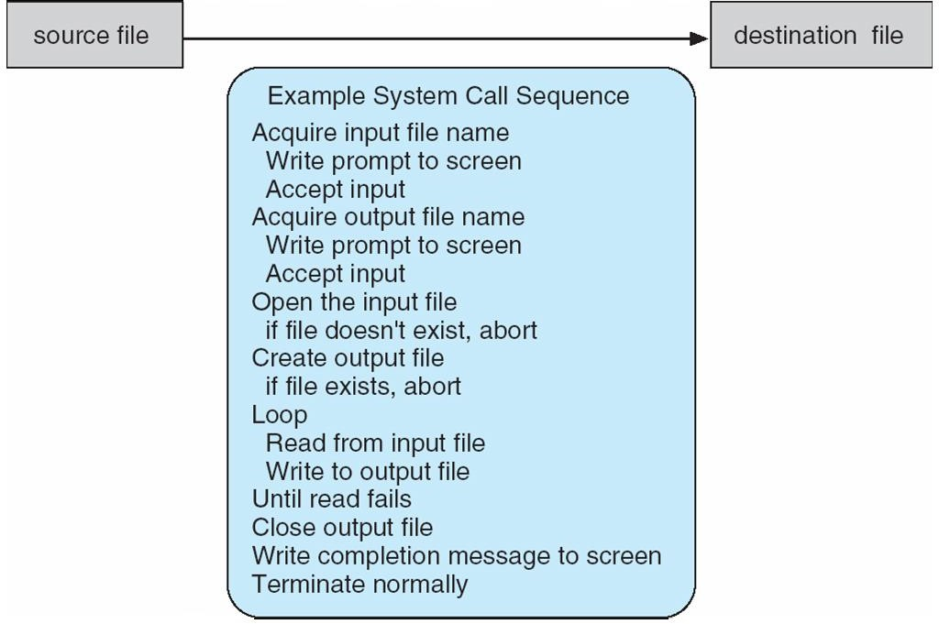
System Calls
System call sequence to copy the contents of one file to another file
26 January 2022
Department of CSE, GIT
19ECS204:Operating System

Slide 118
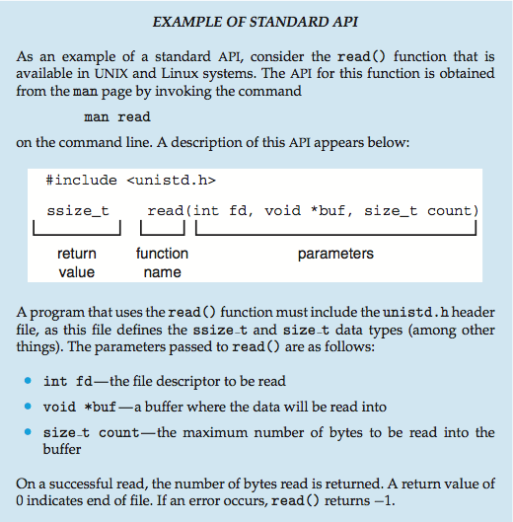
Example of Standard API
26 January 2022
Department of CSE, GIT
19ECS204:Operating System

Slide 119
System Call Implementation
Typically, a number associated with each system call
System-call interface maintains a table indexed according to these numbers
The system call interface invokes the intended system call in OS kernel and returns status of the system call and any return values.
Most programming languages provides a system –call interface that serves as the link to system calls made available by the operating system.
The system –call interface intercepts function calls in the API and invokes the necessary system calls within the operating system.
The caller need know nothing about how the system call is implemented
Just needs to obey API and understand what OS will do as a result call
Most details of OS interface hidden from programmer by API
Managed by run-time support library (set of functions built into libraries included with compiler)
26 January 2022
Department of CSE, GIT
19ECS204:Operating System

Slide 120
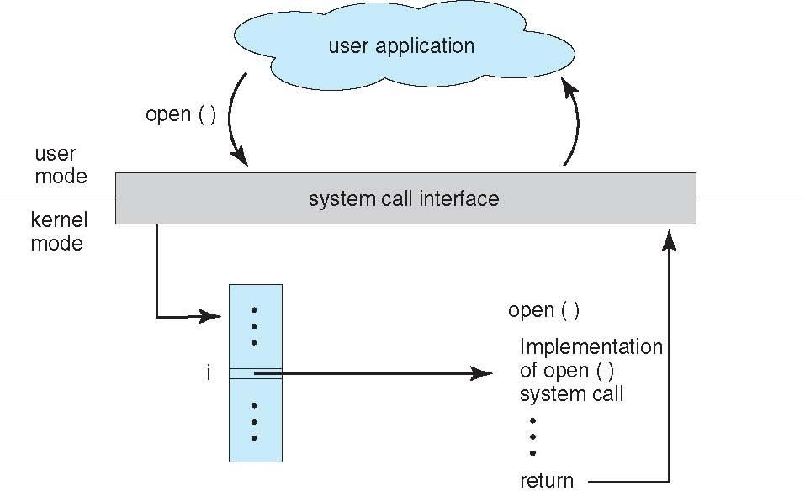
API – System Call – OS Relationship
26 January 2022
Department of CSE, GIT
19ECS204:Operating System

Slide 121
System Call Parameter Passing
Often, more information is required than simply identity of desired system call
Exact type and amount of information vary according to OS and call
Three general methods used to pass parameters to the OS
Simplest: pass the parameters in registers
In some cases, may be more parameters than registers
Parameters stored in a block, or table, in memory, and address of block passed as a parameter in a register .
This approach taken by Linux and Solaris
Parameters placed, or pushed, onto the stack by the program and popped off the stack by
the operating system
Block and stack methods do not limit the number or length of parameters being passed.
26 January 2022
Department of CSE, GIT
19ECS204:Operating System

Slide 122
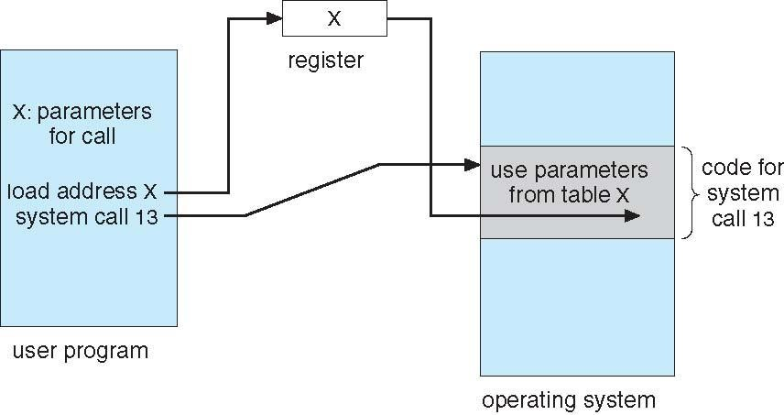
Parameter Passing via Table
26 January 2022
Department of CSE, GIT
19ECS204:Operating System

Slide 123
Types of System calls
The interface between a process and an operating system is provided by system calls.
In general, system calls are available as assembly language instructions.
They are also included in the manuals used by the assembly level programmers.
System calls are usually made when a process in user mode requires access to a resource.
Then it requests the kernel to provide the resource via a system call.
26 January 2022
Department of CSE, GIT
19ECS204:Operating System

Slide 124
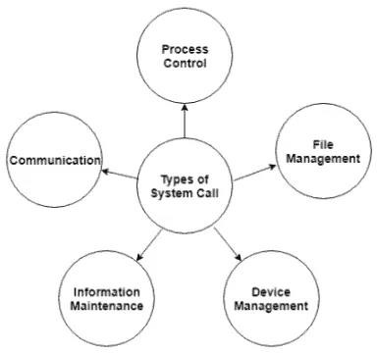
Types of System Calls
Department of CSE, GIT 19ECS204:Operating System

Slide 125
Types of System Calls
Process control
create process, terminate process
end, abort
load, execute
get process attributes, set process attributes
wait for time
wait event, signal event
allocate and free memory
Department of CSE, GIT
125

Slide 126
Types of System Calls
File management
create file, delete file
open, close file
read, write, reposition
get and set file attributes
Device management
request device, release device
read, write, reposition
get device attributes, set device attributes
logically attach or detach devices
Department of CSE, GIT
126

Slide 128
Types of System calls
Information maintenance
get time or date, set time or date
get system data, set system data
get and set process, file, or device attributes
Communications
create, delete communication connection
send, receive messages if message passing model to host name or
process name
From client to server
Shared-memory model create and gain access to memory regions
transfer status information:Acknowledgements,msg is received?/going on?
attach and detach remote devices
Department of CSE, GIT
128

Slide 130

Examples of Systems Calls
Department of CSE, GIT
130

Slide 131

Standard C Library Example
C program invoking printf() library call, which calls write() system call
Department of CSE, GIT
131

Slide 132

Example: MS-DOS
Single-tasking
Shell invoked when system booted
Simple method to run program
– No process created
Single memory space
Loads program into memory, overwriting all but the kernel
Program exit -> shell reloaded
Department of CSE, GIT
132

Slide 133

Example: FreeBSD
FreeBSD(derived from Berkeley UNIX) is an example of a multitasking system.
Because UNIX is a multi-tasking system, the command interpreter remains completely resident when executing a process.
The user can switch back to the command interpreter at any time, and can place the running process in the background even if it was not originally launched as a background process.
In order to do this, the command interpreter first executes a "fork" system call, which creates a second process which is an exact duplicate ( clone ) of the original command interpreter. The child process then executes an "exec" system call, which replaces its code with that of the desired process.
The parent ( command interpreter ) normally waits for the child to complete before issuing a new command prompt, but in some cases it can also issue a new prompt right away, without waiting for the child process to complete.
FreeBSD running multiple programs
Department of CSE, GIT
133

Slide 134
System software
System software is the software that manages the resources and allows a user to interact with the system. It controls a computer's internal working, mostly through an operating system. It also manages peripherals, including printers, storage devices, and monitors.
The data and programs that make up the computer's operating system are known as system software. Printers, hardware drivers, function libraries, system services, system preferences, and other configuration files are included in system files. System software programs examples are file management tools, system utilities, assemblers, debuggers, and compilers.
When you installed the operating system on the computer, the system software is installed. You may also update the software by executing programs like "Windows Update" for Windows and "Software Update" for Mac OS X.

Slide 135

System Programs
System Programming can be defined as the act of building Systems Software using System Programming Languages.
Program Development and Execution can be done conveniently in System Programs. Some of the System Programs are simply user interfaces, others are complex. It traditionally lies between the user interface and system calls.

Slide 136
System Programs
Another phase of OS is the collection of System programs/ System Utilities.
System programs provides a convenient environment for program development and execution.
Some of them are simply user interfaces to system calls and other are more complex.
. System Programs can be divided into:
File manipulation/management
Status information
File modification
Programming language support
Program loading and execution
Communications
Background services
Most users’ view of the operation system is defined by system programs, not the actual system calls
Department of CSE, GIT
136

Slide 137

System Programs
Provide a convenient environment for program development and execution
Some of them are simply user interfaces to system calls; others are considerably more complex
File management -A file is a collection of specific information stored in the memory of a computer system. Create, delete, copy, rename, print, dump, list, and generally manipulate files and directories. File management is defined as the process of manipulating files in the computer system, its management includes the process of creating, modifying and deleting files.
It helps to create new files in the computer system and placing them at specific locations.
It helps in easily and quickly locating these files in the computer system.
It makes the process of sharing files among different users very easy and user-friendly.
It helps to store files in separate folders known as directories.
These directories help users to search files quickly or to manage files according to their types of uses.
Department of CSE, GIT
137

Slide 138
Status information
Some user ask the system for info - date, time, amount of available memory, disk space, number of users
Others provide detailed performance, logging, and debugging information
Typically, these programs format and print the output to the terminal or other output devices
Some systems implement a registry - used to store and retrieve configuration information

Slide 139
System Programs (cont’d)
File modification
For modifying the contents of files we use this.
For Files stored on disks or other storage devices, we used different types of editors. For searching contents of files or perform transformations of files we use special commands.
Programming-language support –
Compilers, assemblers , debuggers and interpreters for common programming languages(C, C++ , Java) are often provided with the operating system or available as a separate download.
Program loading and execution-
Once a program is assembled or compiled, it must be loaded into memory for execution. A loader is part of an operating system that is responsible for loading programs and libraries. It is one of the essential stages for starting a program. Loaders, relocatable loaders, linkage editors, and Overlay loaders are provided by the system.
Communications –
These programs provide a mechanism for connections among processes, users and different computer systems. They allow users to send messages to one another, to browse web pages, games, database system, word processor, send electronic mail messages, transfer of file from one machine to another.
Department of CSE, GIT
139

Slide 140
System Programs (cont’d)
Background Services:
All general purpose systems have methods to initiate certain system program processes at boot time, among them some terminate after completing their task while other programs continue to run until the system is halted. Continuously running system program processes are called services, subsystems or daemons.
Note: Along with system programs, most OS’s are supplied with some application programs like games, web browsers, DB’s, text formatters, compilers, plotting, chatting applications etc.
Some examples of system program in O.S. are –
Windows 10
Mac OS X
Ubuntu
Linux
Unix
Android
Anti-virus
Disk formatting
Computer language translators
Department of CSE, GIT
140

Slide 141
Operating System Design and Implementation
Design and Implementation of OS not “solvable”, but some approaches have proven successful
Internal structure of different Operating Systems can vary widely
Start by defining goals and specifications
Affected by choice of hardware, type of system
User goals and System goals
User goals – operating system should be convenient to use, easy to learn, reliable, safe, and fast
System goals – operating system should be easy to design, implement, and maintain, as well as flexible, reliable, error-free, and efficient
Department of CSE, GIT
141

Slide 142
Operating System Design and Implementation (Cont.)
Important principle to separate Policy:What will be done? Mechanism: How to do it?
Mechanisms determine how to do something, policies decide what will be done
The separation of policy from mechanism is a very important principle, it allows maximum flexibility if policy decisions are to be changed later
Department of CSE, GIT
142

Slide 143
Operating System Structure
Various Structures are:-
Simple structure/Monolithic structure – MS-DOS
More complex -- UNIX
Layered – an abstraction
Microkernel –Mach
Module
Hybrid
Simple/Monolithic Structure
The simplest structure for organizing an operating system is no structure at all. That is, place all of the functionality of, the kernel into a singlestatic binary file that runs in a single address space. This approach—known as a monolithic structure—is a common technique for designing operating system
Department of CSE, GIT
143

Slide 144
Operating System Structure
1.Simple Structure:-
When DOS was originally written its developers had no idea how big and important it would eventually become.
It was written by a few programmers in a relatively short amount of time, without the benefit of modern software engineering techniques, and then gradually grew over time to exceed its original expectations.
It does not break the system into subsystems, and has no distinction between user and kernel modes, allowing all programs direct access to the underlying hardware.
Another Example is UNIX OS, which consists of two separable parts: the kernel and system programs.
The kernel is further separated into a series of interfaces and device drivers,
which have been added and expanded over the years as UNIX has evolved.
The kernel provides the file system, CPU scheduling, memory management, and other OS functions through system calls.
Department of CSE, GIT
144

Slide 145

MS-DOS – written to provide the most functionality in the least space
Not divided into modules
Although MS-DOS has some structure, its interfaces and levels of functionality are not well separated
MS-DOS layer structure

Slide 146

Operating System Structure-Non Simple Structure -- UNIX
UNIX – limited by hardware functionality, the original UNIX operating system had limited structuring. The UNIX OS consists of two separable parts
Systems programs
The kernel
Consists of everything below the system-call interface and above the physical hardware
Provides the file system, CPU scheduling, memory management, and other operating-system functions; a large number of functions for one level.
monolithic structure in the UNIX, Linux, and Windows operating systems
Traditional UNIX system structure
Beyond simple but not fully layered
Department of CSE, GIT
146

Slide 147
Monolithic structure
Advantage:
Simple to design
there is very little overhead in the system-call interface, and communication within the kernel is fast.
Performance is good, there is very little overhead in the system call interface or in communication within the kernel.
Disadvantages:
difficult to implement ,maintain and extend because most of the OS functionality( like file handling,CPU scheduling,Memory management etc are placed into one layer i.e.kernel ) is provided in least space.
Do not have a well defined structure.
In MS-DOS, the interfaces and levels of functionality are not well separated.i.e. application programs are able to access the basic I/O routines to write directly to the display and disk drives. Such freedom leaves MS-DOS vulnerable to errant (or malicious) programs, causing entire system crashes when user programs fail.
Limited by hardware function, i.e. no hardware protection
The monolithic approach is often known as a tightly coupled system because changes to one part of the system can have wide-ranging effects on other parts

Slide 148

Operating System Structure
2.Layered Approach
The operating system is divided into a number of layers (levels), each built on top of lower layers. The bottom layer (layer 0), is the hardware; the highest (layer N) is the user interface.
An operating-system layer is an implementation of an abstract object made up of data and the operations that can manipulate those data. A typical operating-system layer—say, layer M—consists of data structures and a set of routines that can be invoked by higher-level layers. Layer M, in turn, can invoke operations on lower-level layers.
With modularity, layers are selected such that each uses functions (operations) and services of only lower-level layers
This approach allows each layer to be developed and debugged independently, with the assumption that all lower layers have already been debugged and are trusted to deliver proper services.
Department of CSE, GIT
148

Slide 150
Layered
loosely coupled system. Such a system is divided into separate, smaller components that have specific and limited functionality. All these components together comprise the kernel. The advantage of this modular approach is that changes in one component affect only that component, and no others, allowing system implementers more freedom in creating and changing the inner workings of the system

Slide 151
Layered
Advantages:
Very modular
Easy to debug ,Simplicity in construction because if an error is found during the debugging of a particular layer, the error must be on that layer, because the layers below it are already debugged. Thus, the design and implementation of the system are simplified.
Each layer is implemented only with operations provided by lower-level layers. A layer does not need to know how these operations are implemented; it needs to know only what these operations do. Hence, each layer hides the existence of certain data structures, operations, and hardware from higher-level layers
Disadvantage:
appropriately defining the various layers. Because a layer can use only lower-level layers, careful planning is necessary.
There is communication overhead in between layers
Less efficient because system call execution takes more time. For instance, when a user program executes an I/O operation, it executes a system call that is trapped to the I/O layer, which calls the memory-management layer, which in turn calls the CPU-scheduling layer, which is then passed to the hardware. At each layer, the parameters may be modified, data may need to be passed, and so on. Each layer adds overhead to the system call. The net result is a system call that takes longer than does one on a nonlayered system
Layered systems have been successfully used in computer networks (such as TCP/IP) and web applications. Nevertheless, relatively few operating systems use a pure layered approach. One reason involves the challenges of appropriately defining the functionality of each layer. In addition, the overall performance of such systems is poor due to the overhead of requiring a user program to traverse through multiple layers to obtain an operating-system service

Slide 152
Microkernel System Structure
This method structures the operating system by removing all nonessential components from the kernel and implementing them as system and user-level programs. The result is a smaller kernel.
microkernels provide minimal process and memory management, in addition to a communication facility.
Moves as much from the kernel into user space
Mach example of microkernel
Mac OS X kernel (Darwin) partly based on Mach
Communication takes place between user modules using message passing
Benefits:
Easier to extend a microkernel
Easier to port the operating system to new architectures
More reliable (less code is running in kernel mode)
More secure
Detriments:
Performance overhead of user space to kernel space communication

Slide 153
Operating System Structure
3. Microkernels
The basic idea behind micro kernels is to remove all non-essential services from the kernel, and implement them as system applications instead, thereby making the kernel as small and efficient as possible.
Most microkernels provide basic process and memory management, and message passing between other services, and not much more.
Security and protection can be enhanced, as most services are performed in user mode, not kernel mode.
System expansion can also be easier, because it only involves adding more system applications, not rebuilding a new kernel.
Mach was the first and most widely known microkernel, and now forms a major component of Mac OSX.
Department of CSE, GIT
153

Slide 154

Microkernel System Structure
Tru64 UNIX (formerly Digital UNIX) provides a UNIX interface to the user, but it is implemented with a Mach kernel
The Mac OS X kernel (also known as Darwin) is also partly based on the Mach microkernel
Another example is QNX, a real-time operating system for embedded systems
Architecture of a typical microkernel
Department of CSE, GIT
154

Slide 155
Microkernel
Advantages
extending the operating system easier. All new services are added to user space and consequently do not require modification of the kernel. When the kernel does have to be modified, the changes tend to be fewer, because the microkernel is a smaller kernel.
The resulting operating system is easier to port from one hardware design to another because microkernel is small.
The microkernel also provides more security and reliability, since most services are running as user—rather than kernel—processes. If a service fails, the rest of the operating system remains untouched.

Slide 156
Microkernel
Disadvantages
Unfortunately, the performance of microkernels can suffer due to increased system-function overhead. When two user-level services must communicate, messages must be copied between the services, which reside in separate address spaces.
In addition, the operating system may have to switch from one process to the next to exchange the messages. The overhead involved in copying messages and switching between processes has been the largest impediment to the growth of microkernel-based operating systems

Slide 157
Modules
Many modern operating systems implement loadable kernel modules
Here, the kernel has a set of core components and links in additional services via modules, either at boot time or during run time. This type of design is common in modern implementations of UNIX, such as Solaris, Linux, and Mac OS X, as well as Windows.
Uses object-oriented approach
Each core component is separate
Each talks to the others over known interfaces
Each is loadable as needed within the kernel
Overall, similar to layers but with more flexible
Linux, Solaris, etc

Slide 158
Modular
Modern OS development is object-oriented, with a relatively small core kernel and a set of modules which can be linked in dynamically.
Modules are similar to layers in that each subsystem has clearly defined tasks
and interfaces, but any module is free to contact any other module
The kernel is relatively small in this architecture, similar to microkernels, but the kernel does not have to implement message passing since modules are free to contact each other directly.
The idea of the design is for the kernel to provide core services while other services are implemented dynamically, as the kernel is running.
The overall result resembles a layered system in that each kernel section has defined, protected interfaces; but it is more flexible than a layered system, because any module can call any other module.
The approach is also similar to the microkernel approach in that the primary module has only core functions and knowledge of how to load and communicate with other modules; but it is more efficient, because modules do not need to invoke message passing in order to communicate
Department of CSE, GIT
158

Slide 159

Solaris Modular Approach
The Solaris operating system structure, shown in Figure is organized around a core kernel with seven types of loadable kernel modules
Linux also uses loadable kernel modules, primarily for supporting device drivers and file systems.
Solaris loadable modules
Department of CSE, GIT
159

Slide 160
Hybrid Systems
Most modern operating systems are actually not one pure model
Hybrid combines multiple approaches to address performance, security, usability needs
Linux and Solaris kernels in kernel address space, so monolithic, plus modular for dynamic loading of functionality
Windows mostly monolithic, plus microkernel for different subsystem personalities
Apple Mac OS X hybrid, layered, Aqua UI plus Cocoa programming environment
Below is kernel consisting of Mach microkernel and BSD Unix parts, plus I/O kit and dynamically loadable modules (called kernel extensions)

Slide 161
Mac OS X Structure

Slide 162
iOS
Apple mobile OS for iPhone, iPad
Structured on Mac OS X, added functionality
Does not run OS X applications natively
Also runs on different CPU architecture (ARM vs. Intel)
Cocoa Touch Objective-C API for developing apps
Media services layer for graphics, audio, video
Core services provides cloud computing, databases
Core operating system, based on Mac OS X kernel

Slide 163
Android
Developed by Open Handset Alliance (mostly Google)
Open Source
Similar stack to IOS
Based on Linux kernel but modified
Provides process, memory, device-driver management
Adds power management
Runtime environment includes core set of libraries and Dalvik virtual machine
Apps developed in Java plus Android API
Java class files compiled to Java bytecode then translated to executable than runs in Dalvik VM
Libraries include frameworks for web browser (webkit), database (SQLite), multimedia, smaller libc

Slide 164
Android Architecture

Slide 165
Operating-System Debugging
Debugging is finding and fixing errors, or bugs
OS generate log files containing error information
Failure of an application can generate core dump file capturing memory of the process
Operating system failure can generate crash dump file containing kernel memory
Beyond crashes, performance tuning can optimize system performance
Sometimes using trace listings of activities, recorded for analysis
Profiling is periodic sampling of instruction pointer to look for statistical trends
Kernighan’s Law: “Debugging is twice as hard as writing the code in the first place. Therefore, if you write the code as cleverly as possible, you are, by definition, not smart enough to debug it.”

Slide 166

DTrace
DTrace tool in Solaris, FreeBSD, Mac OS X allows live instrumentation on production systems
Probes fire when code is executed within a provider, capturing state data and sending it to consumers of those probes
Example of following XEventsQueued system call move from libc library to kernel and back

Slide 167


Dtrace (Cont.)
DTrace code to record amount of time each process with UserID 101 is in running mode (on CPU) in nanoseconds

Slide 168
Operating System Generation
Operating systems are designed to run on any of a class of machines; the system must be configured for each specific computer site
SYSGEN program obtains information concerning the specific configuration of the hardware system
Used to build system-specific compiled kernel or system-tuned
Can general more efficient code than one general kernel

Slide 169
System Boot
When power initialized on system, execution starts at a fixed memory location
Firmware ROM used to hold initial boot code
Operating system must be made available to hardware so hardware can start it
Small piece of code – bootstrap loader, stored in ROM or EEPROM locates the kernel, loads it into memory, and starts it
Sometimes two-step process where boot block at fixed location loaded by ROM code, which loads bootstrap loader from disk
Common bootstrap loader, GRUB, allows selection of kernel from multiple disks, versions, kernel options
Kernel loads and system is then running

Slide 170
System Boot
The process of starting a computer by loading the kernel is known as booting.
The BIOS initiates the booting processby loading the Master Boot Record(MBR) from a device.MBR ccontains OS boot loader.
On most computer systems, a small piece of code known as bootstrap program or bootstrap loader locates the kernel loads it into the main memory and starts its execution.
The bootstrap program can perform a variety of tasks. Usually ,one task is to run diagnostics to determine the state of the machine.
When the system powers up, an interrupt is generated which loads a memory address into the program counter, and the system begins executing instructions found at that address. This address points to the "bootstrap" program located in ROM chips ( or EPROM chips ) on the motherboard.
The ROM bootstrap program first runs hardware checks, determining what physical resources are present and doing power-on self tests ( POST ) of all HW for which this is applicable. Some devices, such as controller cards may have their own on-board diagnostics, which are called by the ROM bootstrap program.
Department of CSE, GIT
170

Slide 171


Slide 172

THANK YOU
Department of CSE, GIT
172

Slide 173
SYSTEM BOOT

Slide 174
THANK YOU

